Slide 1
Direct Bank Marketing
OPIM - 5512 Python
Professor Ramesh Shankar
Team 6
Ayush Kumar
Madhuri Koyilakonda
Latisha Douglas
Xiang Yu

Slide 2

Agenda
1
Background
2
Data Description & Data Visualization
3
Data Transformations
4
Predictive Modeling
5
Findings & Recommendations

Slide 3
1
Background
Financial organizations often struggle with differentiating themselves from competitors, who often use similar tactics, market to the same demographics and offer similar or even the same rates and services. Because of increased competition, it becomes vital for the bank to maximize their marketing and determine those clients who would most likely subscribe to a term account deposit.

Slide 4

Background
Purpose: This project is about predicting potential customers who would subscribe to a term deposit account from a Portuguese banking institution
How: Analyze and model the data related to the bank’s past direct marketing campaign.

Slide 5
2
Data Description & Visualization

Slide 6
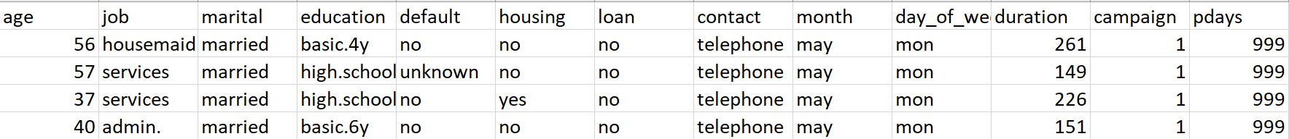
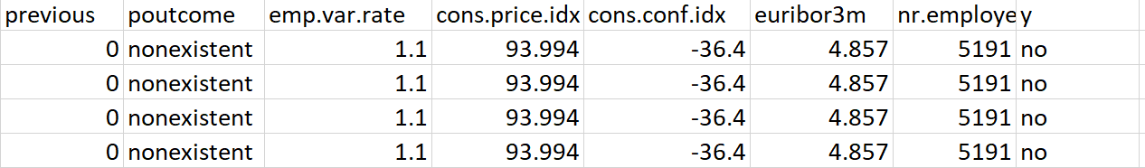
Data Description
Number of Rows: 41,188
Number of Variables: 21
Data Source: https://archive.ics.uci.edu/ml/datasets/bank+marketing

Slide 7
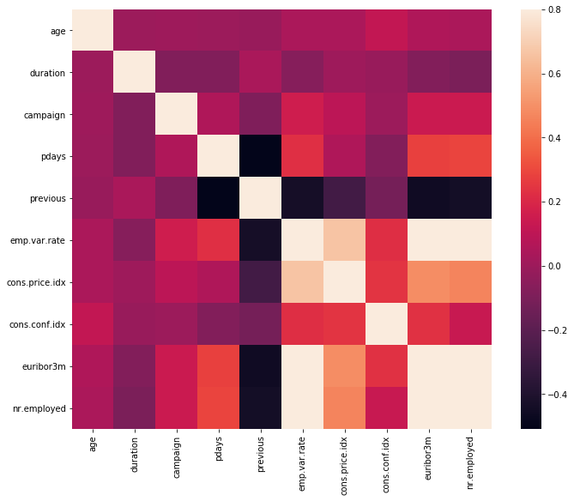
Heat Map

Slide 8
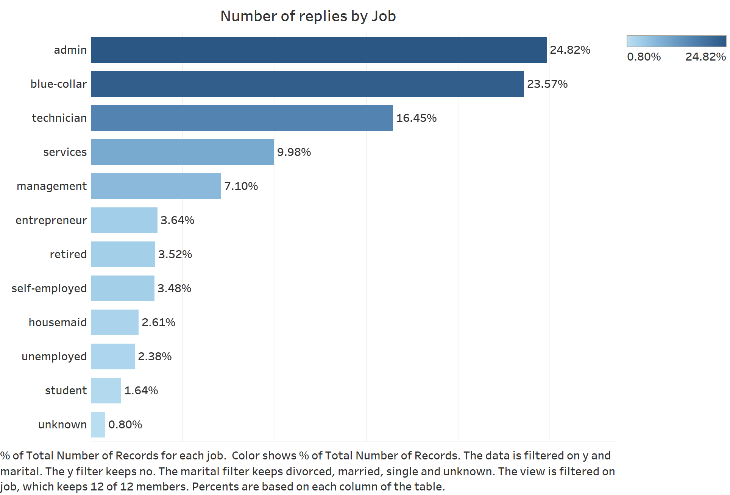
Data Visualization

Slide 9
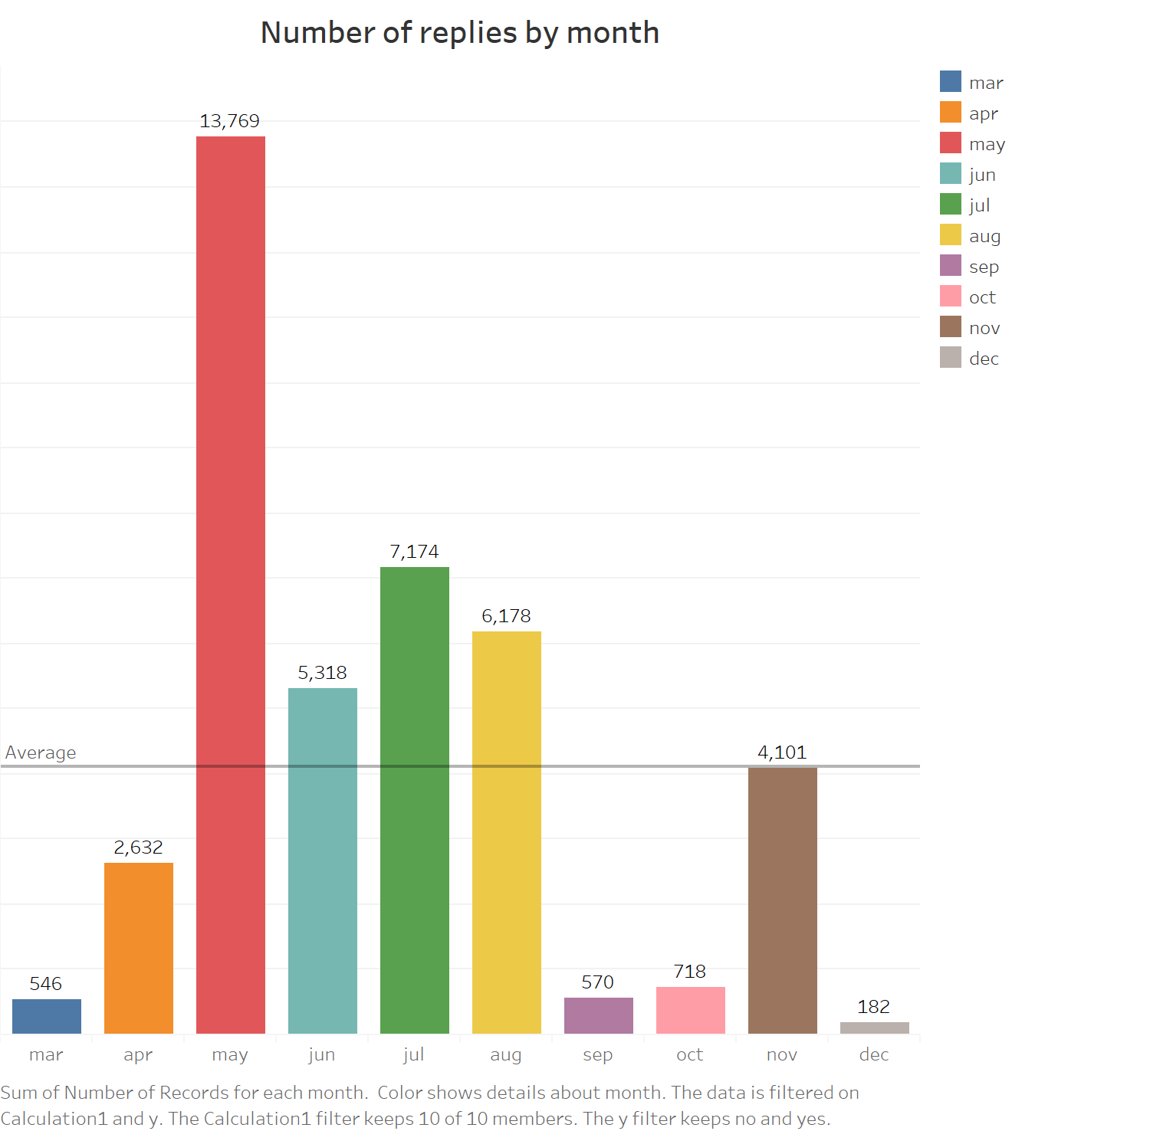
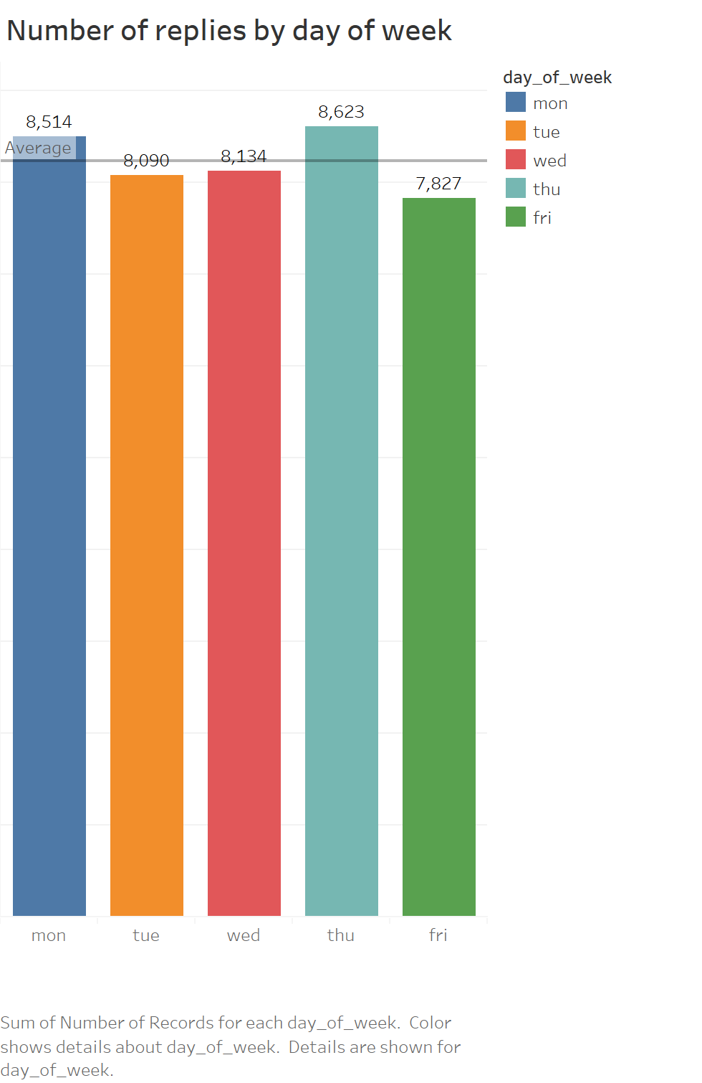
Data Visualization
Customers Contacted by Month
Customers Customers Contacted by Day

Slide 10
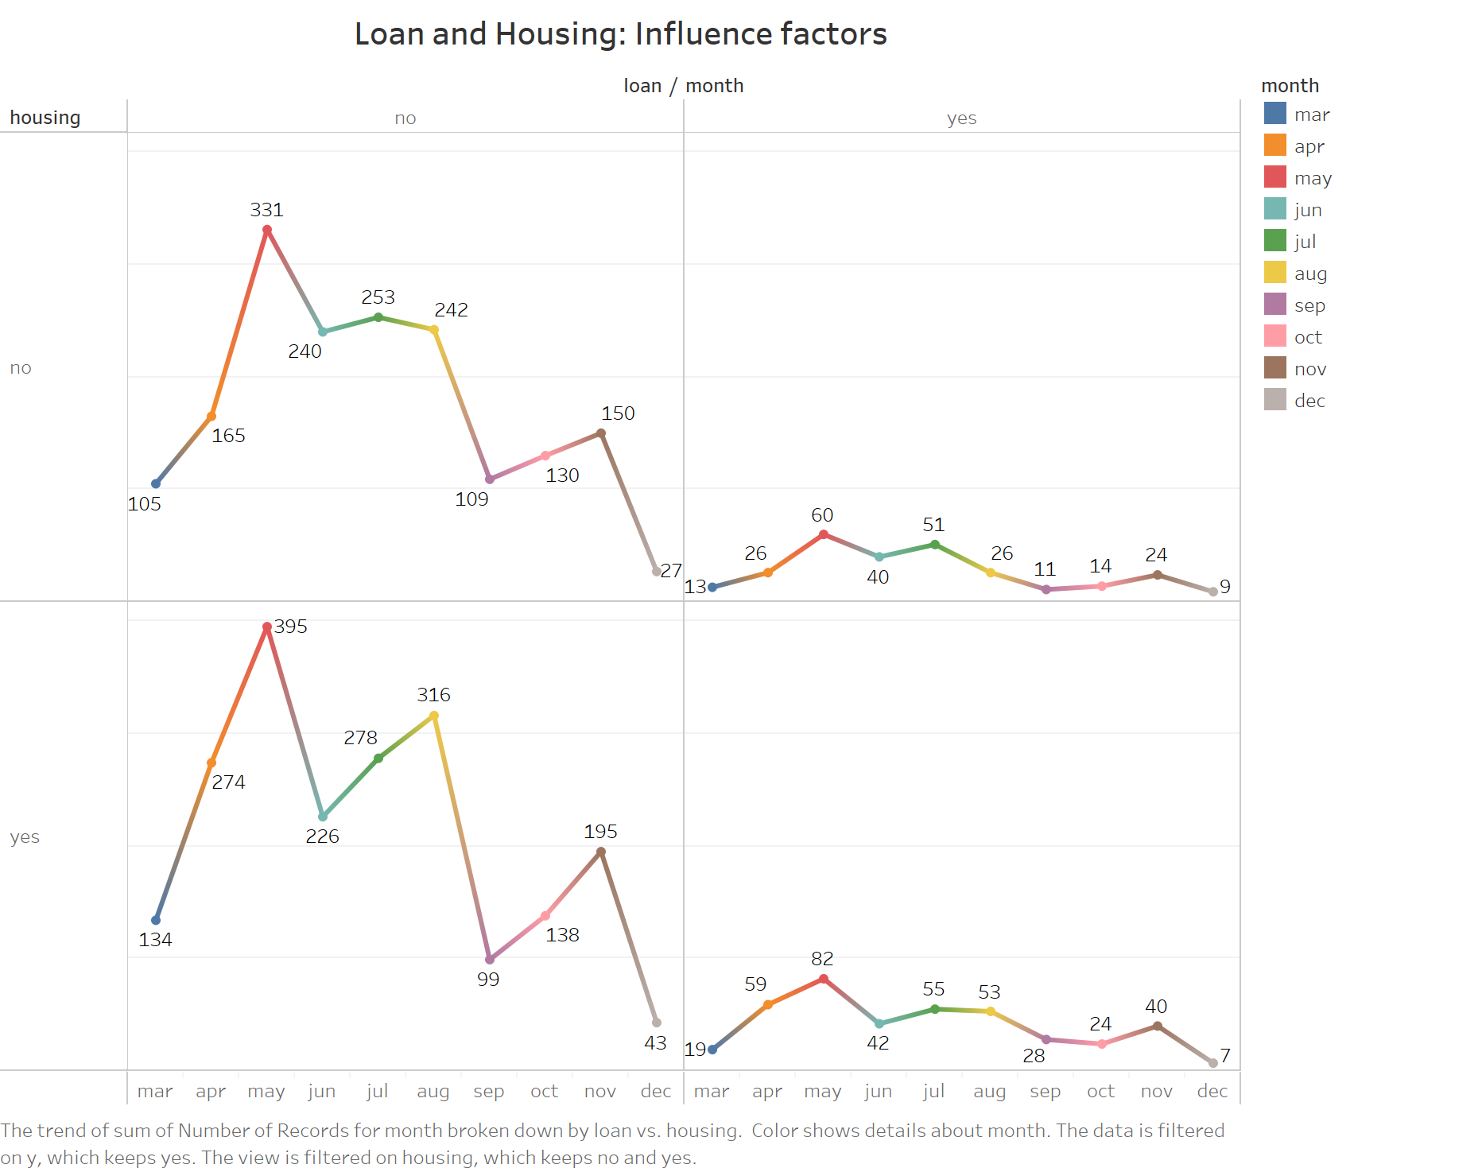
Data Visualization

Slide 11
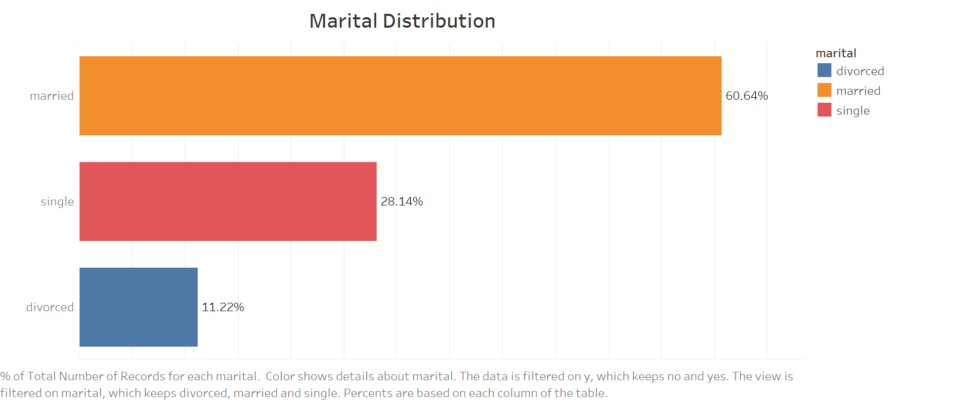
Data Visualization

Slide 12
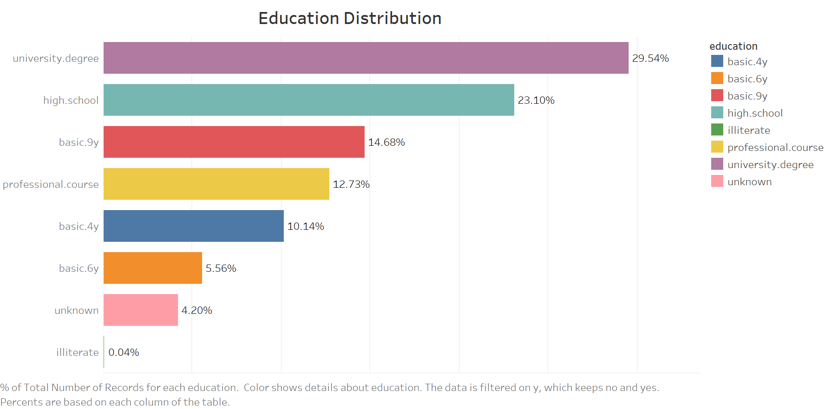
Data Visualization

Slide 13
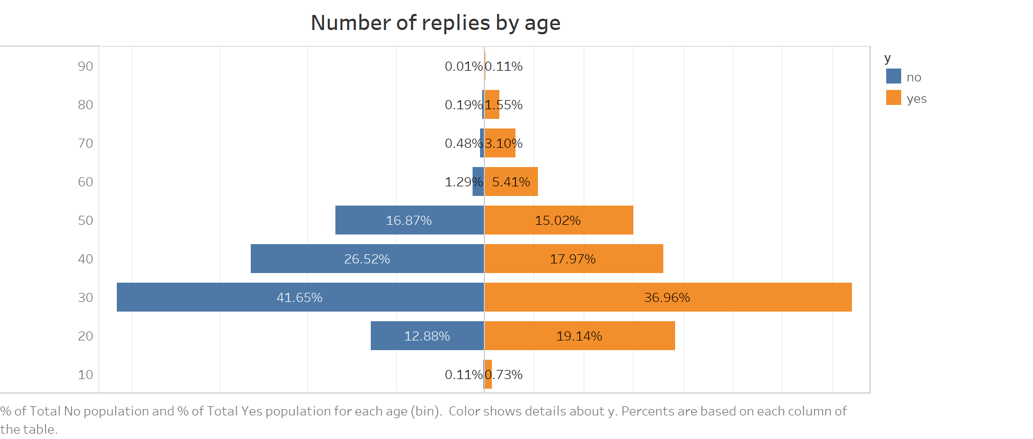
Data Visualization

Slide 14
3
Data Transformations

Slide 15
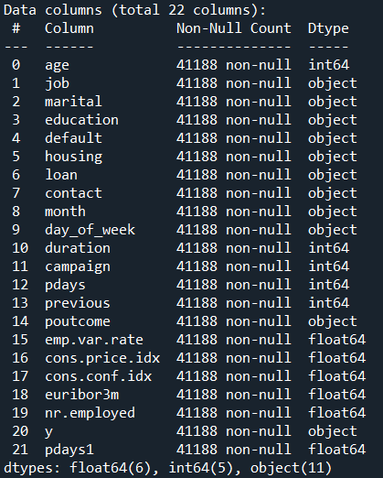
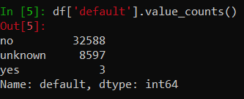
Data Transformations

Slide 16
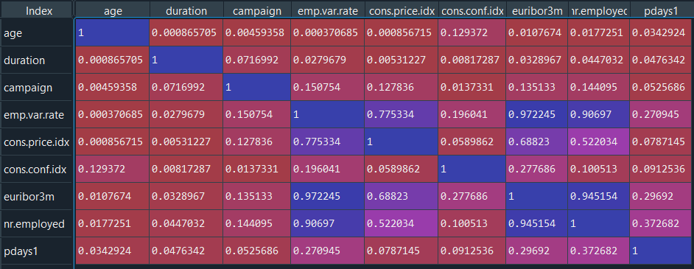
Data Transformations – Correlation matrix
cons.price.idx
eurobinr1
nr.employed

Slide 17
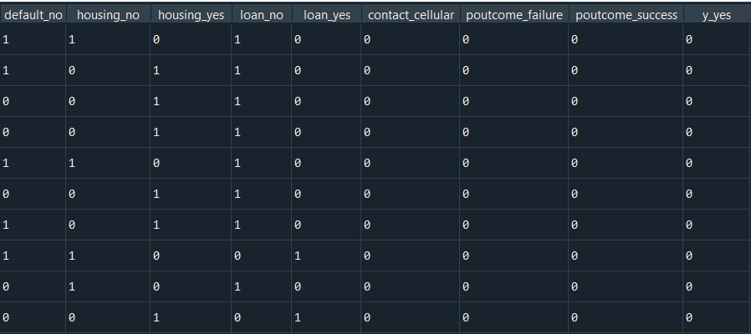
Data Transformations – Dummy Variables
default
housing
loan
contact
poutcome
target y_yes

Slide 18
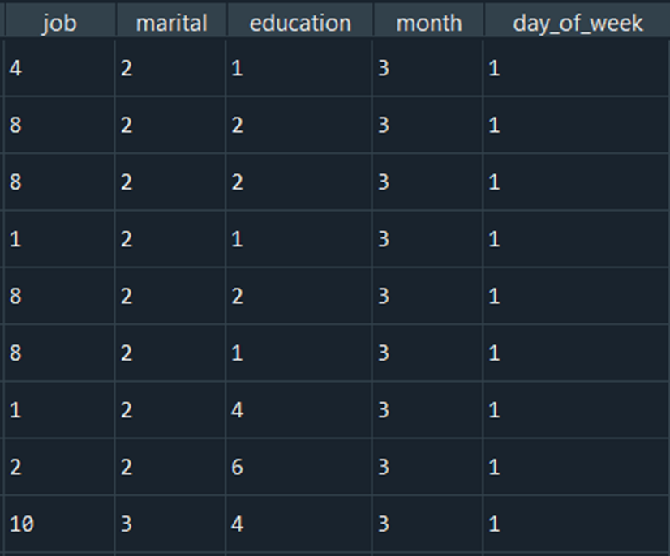
Data Transformations
Categorical variables to corresponding numbers ：
job
marital
education(basic =basic.9y, basic.6y, basic.4y)
month
day_of_week

Slide 19
4
Predictive Modeling

Slide 20
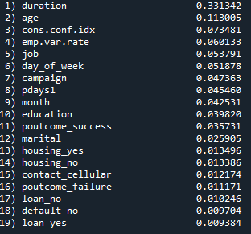
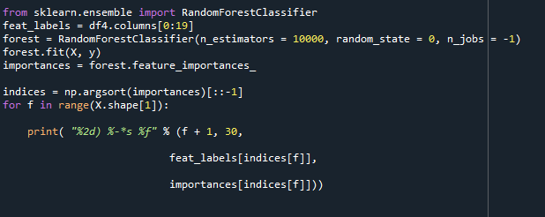
Modeling – Variable Selection
Column contribution using Random forest

Slide 21
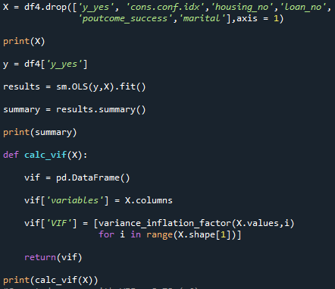
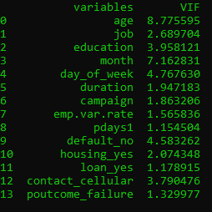
Modeling – Eliminating Variables
with VIF > 6
6 Iterations

Slide 22
Data Split and Standardization
Split Data
Baseline
Standardization
Training : Test
70 : 30
Baseline Accuracy for test Partition = 11.35 %
The Numerical columns are standardized before Modeling

Slide 23
Modeling
Neural Networks
Logistic Regression
6
1
Random Forests
5
Models
2
Perceptron
4
3
Naïve Bayes
SVM

Slide 24
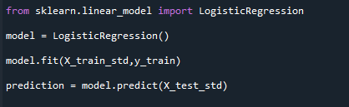
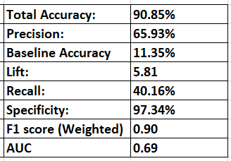
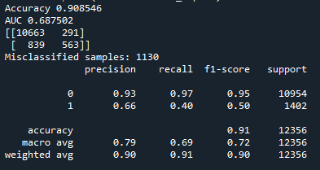
Logistic Regression
1

Slide 25
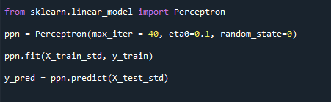
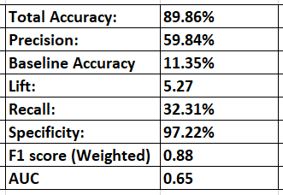
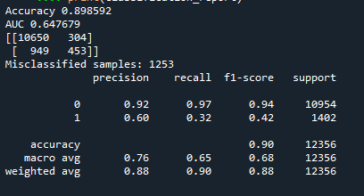
Perceptron
2

Slide 26
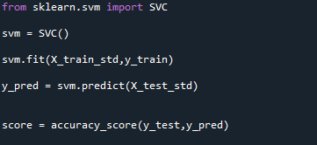
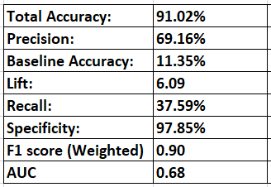
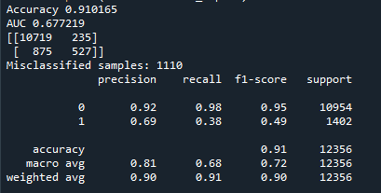
SVM
3

Slide 27
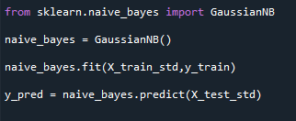
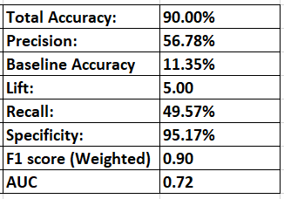
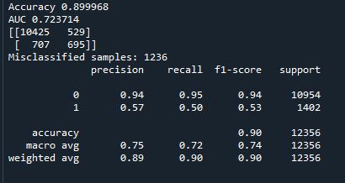
Naïve Bayes
4

Slide 28
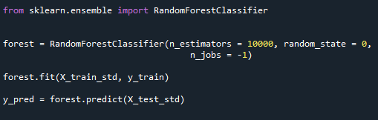
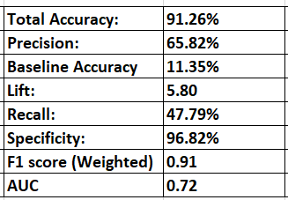
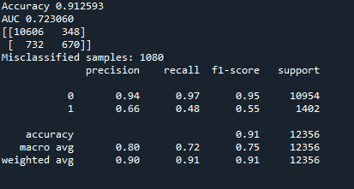
Random Forests
5

Slide 29
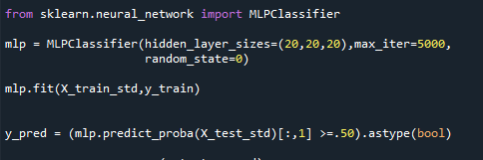
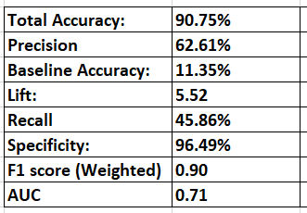
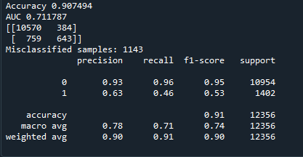
Neural Networks
6

Slide 30
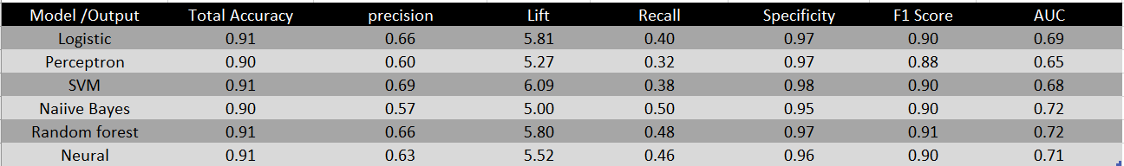
Model Comparison
Best Model: Naive Bayes
Low count of False Negatives and High Recall

Slide 31
5
Findings & Recommendations

Slide 32
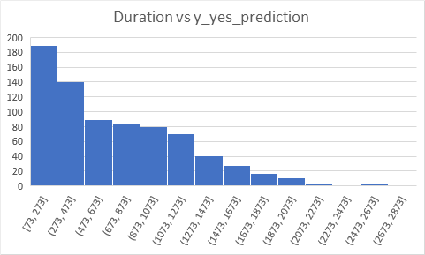
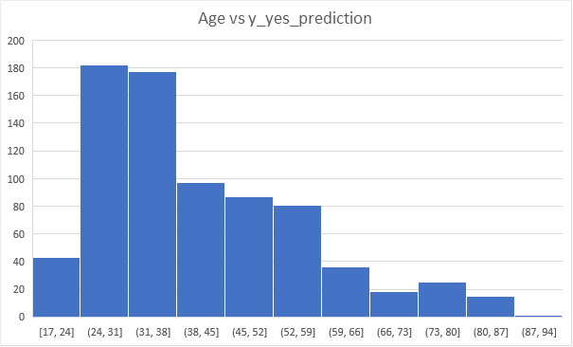
Findings & Recommendations

Slide 33
Findings & Recommendations
TTT
Precision Marketing
Targeted Marketing
Make precise marketing strategy to main customer:admin, blue-collar and technician
Marketing calls that
end within 8 minutes are more likely to get customers to subscribe to a term deposit.
Marketing Campaigns should be more targeted to Age group 24 to 38
Time Tracking

Slide 34
Questions
Answers

